Slide 1
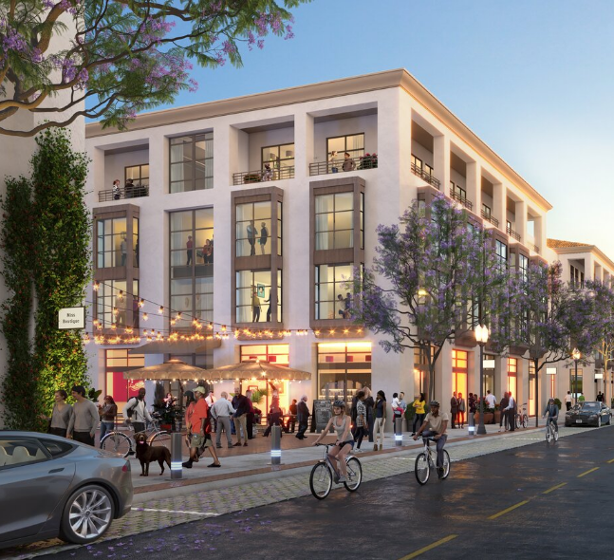
XXXXX 2024 TruTrade Report of Findings
Do a Find & Replace (Ctrl+H) to replace all XXXXX with the correct study Location Name
Replace the photo with one of the client location or location being analyzed (Height: 7.92” x Width: 8.68”)
Update the client logo
Delete this box
REPLACE WITH CLIENT LOGO
Do a Find & Replace (Ctrl+H) to replace all
“Source: TruTrade, 12 months ending on March 31, 2022; Esri”
with the correct end date
June 30, 2025

Slide 2
Report contents
Executive summary
Key findings
Recommendations
XXXXX visitor overview
On-site visitor behavior
Competitive landscape
Appendix

Slide 3
Executive Summary
Insert photo of the client location or location being analyzed and resize/crop to fit properly, then ‘Send to back’
(Height: 14.0” x Width: 6.39”)
Delete this box

Slide 4
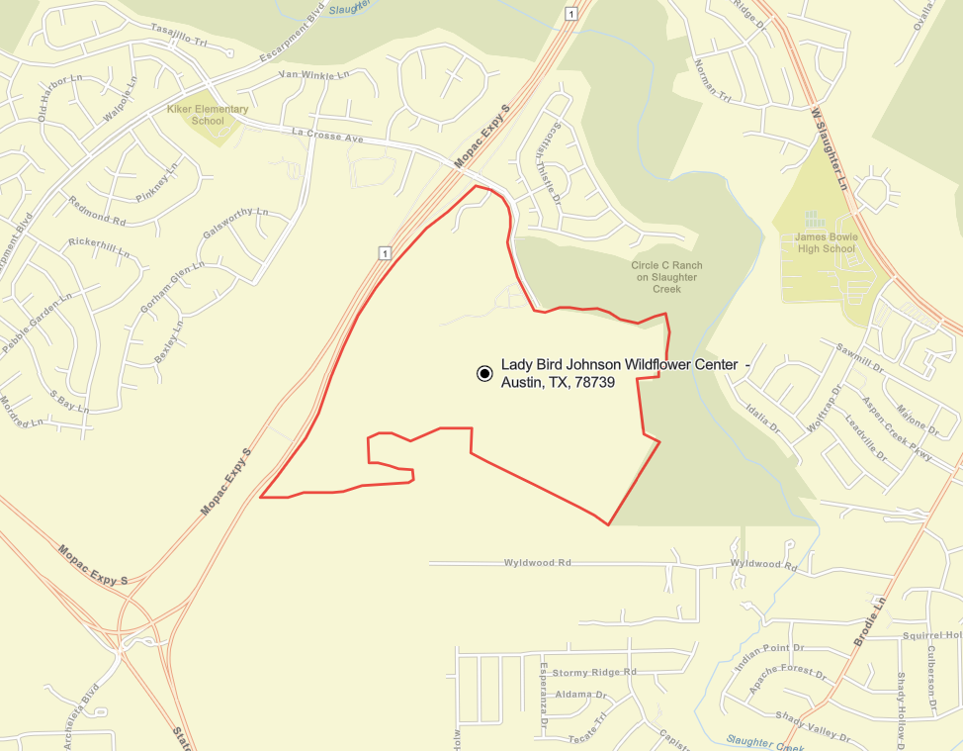
Mobile devices seen within the shaded (geo-fenced) area were analyzed to determine the where, who and what of actual visitors to XXXXX
Geofence image to include full boundaries at appropriate zoom level
Time period of the data: September 2023 – August 2024

Slide 5
Summary of Key Findings
Text
IGNORE – ANALYST WILL UPDATE

Slide 6
Key Implications
Text
IGNORE – ANALYST WILL UPDATE

Slide 7
XXXXX Trade Area Overview

Slide 8









XXXXX Actual Visitors Key Metrics
XXXXX
Visitor Data:
COMPARED TO THE MARKET
HH08
OF THE VISITOR HOUSEHOLDS EARN $100K+ A YEAR
VS. 37% IN MSA
VL10
of visitors live within 10 miles of XXXXX
DRAWS FROM A VISITOR ORIGIN POPULATION OF VOP08
HHI08
vs. HHIMSA08
AVERAGE VISITOR ANNUAL HOUSEHOLD INCOME VS. THE MSA
LD08
OF VISITORS LIVE WITHIN A 50-MILE LOCAL TRAVEL DISTANCE
TOP 5 ZIPS BASED ON PERCENT OF VISITS
CD08
OF VISITORS HAVE A COLLEGE OR POST-GRADUATE DEGREE VS. 44% IN THE MSA
MT08
OF VISITORS COME FROM BEYOND 50-MILE TOURIST TRAVEL DISTNCE
ZIP1
ZIP2
ZIP3
ZIP4
ZIP5
VC08
OF VISITORS HAVE CHILDREN UNDER 18 LIVING AT HOME VS. 35% IN THE MSA
ETHNIC MAKEUP
AVG. ANNUAL VISIT FREQUENCY
VISIT DWELL TIME
VF08 visits
DT08 minutes

Slide 9
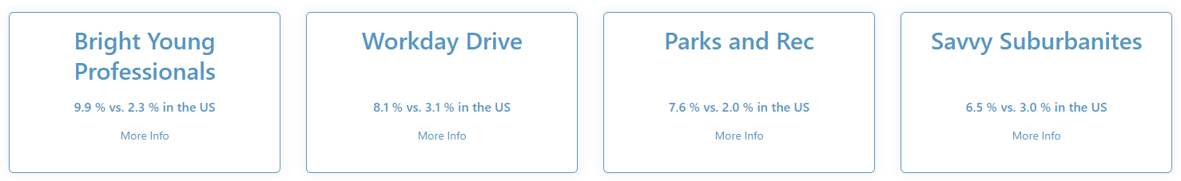
[Destination Name]
Visitor Personas
Get Tapestry Data from Dashboard > Overview> Tapestry Profile
Top 4 Visitor Personas
MSA Index: 100
MSA Index: 100
MSA Index: 100
MSA Index: 100
Bright Young Professionals is a large market, primarily located in urban outskirts of large metropolitan areas. These communities are home to young, educated, working professionals. More than one out of three householders are under the age of 35. Slightly more diverse couples dominate this market, with more renters than homeowners.
Workday Drive is an affluent, family-oriented market with a country flavor. Residents are partial to new housing away from the bustle of the city but close enough to commute to professional job centers. Life in this suburban wilderness offsets the hectic pace of two working parents with growing children. They favor time-saving devices, like banking online or housekeeping services, and family-oriented pursuits.
These suburbanites have achieved the dream of home -ownership. They have purchased homes that are within their means. Their homes are older, and townhomes and duplexes are not uncommon. Many of these families are two-income married couples approaching retirement age; they are comfortable in their jobs and their homes, budget wisely, but do not plan on retiring anytime soon or moving.
Savvy Suburbanites residents are well educated, well read, and well capitalized. Families include empty nesters and empty nester wannabes, who still have adult children at home. Located in older neighborhoods outside the urban core, their suburban lifestyle includes home remodeling and gardening plus the active pursuit of sports and exercise. They enjoy good food and wine, plus the amenities of the city’s cultural events.
Replace Tapestry source
“Source: TruTrade (January 2023 - December 2023); Tapestry Esri”
with the correct end date
Source: TruTrade (January 2023 - December 2023); Tapestry Esri
9

Slide 10
CMPANALYSIS10
 | TruTrade Population | Visitor Avg. HH Income | % Visitors >$100,000 HHI | Avg. Age of Head of Visitor Household | % Visitor Households with Children | % College Degree or Higher
Source: TruTrade, 12 months ending on March 31, 2022; Esri

Slide 11
MILANALYSIS11
 |  | Potential Visitors |  |  | Actual Visitors | Actual vs. 10 mi Potential
2024 Estimated Demographics |  | 3 miles | 5 miles | 10 miles | TruTrade | Index
Population |  | MA121 | MB121 | MC121 | MD121
Households |  | MA122 | MB122 | MC122 | MD122
Age | 18-24 | MA123 | MB123 | MC123 | MD123
 | 25-34 | MA124 | MB124 | MC124 | MD124
 | 35-44 | MA125 | MB125 | MC125 | MD125
 | 45-54 | MA126 | MB126 | MC126 | MD126
 | 55-64 | MA127 | MB127 | MC127 | MD127
 | 65+ | MA128 | MB128 | MC128 | MD128
 | Average Age | MA129 | MB129 | MC129 | MD129
HH Income | Less than $50,000 | MA130 | MB130 | MC130 | MD130
 | $50,000 - $74,999 | MA131 | MB131 | MC131 | MD131
 | $75,000 - $99,000 | MA132 | MB132 | MC132 | MD132
 | $100,000 - $149,999 | MA133 | MB133 | MC133 | MD133
 | $150,000 or more | MA134 | MB134 | MC134 | MD134
 | Average Household Income | MA135 | MB135 | MC135 | MD135
Children in Household |  | MA136 | MB136 | MC136 | MD136
Education | Less than College | MA137 | MB137 | MC137 | MD137
 | Some College | MA138 | MB138 | MC138 | MD138
 | College Degree | MA139 | MB139 | MC139 | MD139
 | Post-Graduate Degree | MA140 | MB140 | MC140 | MD140
Ethnicity | Caucasian/White | MA141 | MB141 | MC141 | MD141
 | African-American/Black | MA142 | MB142 | MC142 | MD142
 | Hispanic/Latino | MA143 | MB143 | MC143 | MD143
 | Asian | MA144 | MB144 | MC144 | MD144
 | Other | MA145 | MB145 | MC145 | MD145
Source: TruTrade, 12 months ending on March 31, 2022; Esri

Slide 12
DDANALYSIS12
AGE
18-24
25-34
35-44
45-54
55-64
65+
Average Age
HOUSEHOLD INCOME
Less than $50,000
$50,000-$74,999
$75,000-$99,999
$100,000-$149,999
$150,000 or more
Average HH Income
CHILDREN IN HOUSEHOLD
EDUCATION
Less than college
Some college
College degree
Post-graduate degree
ETHNICITY
Caucasian/White
African-American/Black
Hispanic/Latino
Asian
Other
Source: TruTrade, 12 months ending on March 31, 2022; Esri

Slide 13
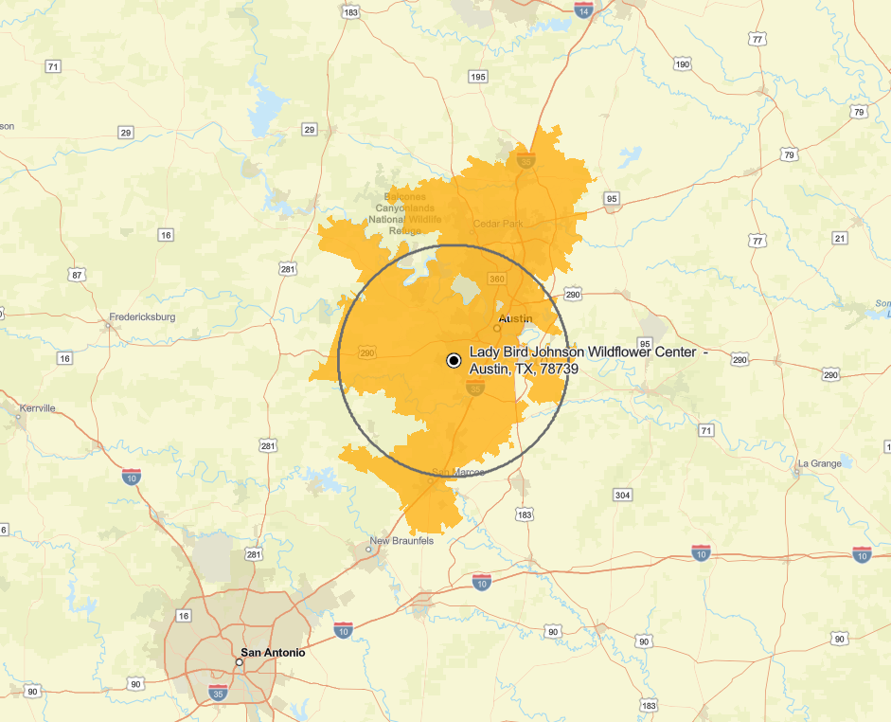
XXXXX Visitor Origin – Regional View
One zoom out from default zoom.
Legend
20 miles
Top 75% of Visits

Slide 14
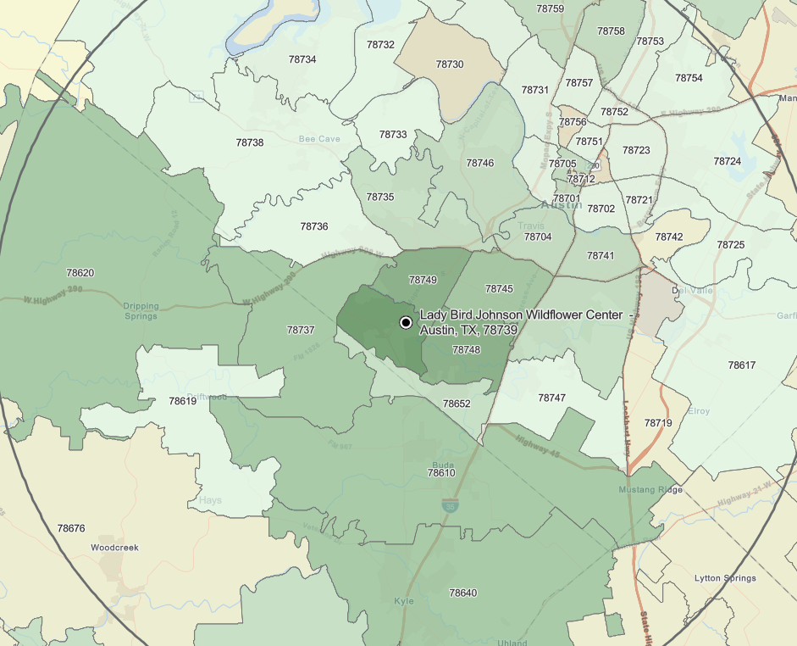
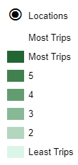
XXXXX Most Trips – Local View
…
MOST TRIPS MAP (not yellow TA map) One zoom in from default zoom.

Slide 15
ZIPANALYSIS15
ZIP | City | State | Miles from ZIP to XXXXX | Percent of Visits | Cumulative Percent Visits | Total Households | Total Population | 5-Year Population Growth | Average HH Income
Source: TruTrade, 12 months ending on March 31, 2022; Esri

Slide 16
On-Site Visitor Behavior
Insert photo of the client location or location being analyzed and resize/crop to fit properly, then ‘Send to back’
(Height: 14.0” x Width: 6.39”)
Delete this box

Slide 17
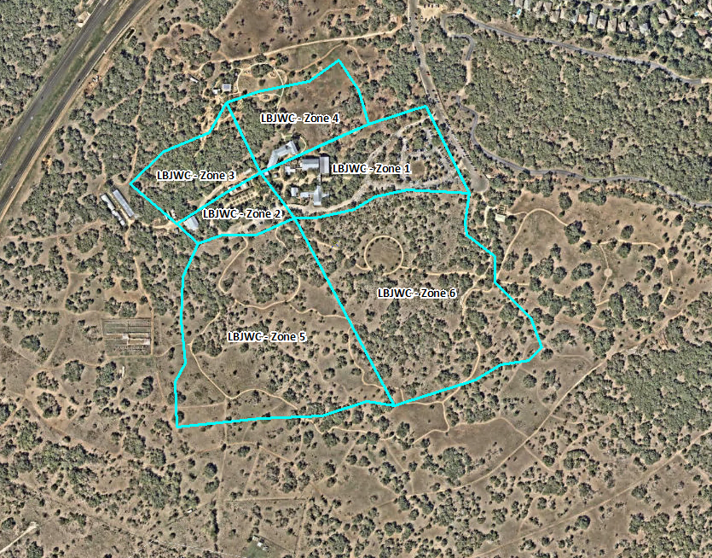
XXXXX Zone Analysis
Process ZA using the CV Notebook https://dbc-4659a8af-9737.cloud.databricks.com/?o=5020840785703105#notebook/4268345134498833
Number of Zones Visited | Percent of All Visitors
One Zones Only
Two Zones Only
Three Zones Only
Four Zones
Five Zones
Six Zones
Specific Areas Visited | Percent of All Visitors

Slide 18
Update links in charts to link to the workbook (Click on chart > Edit Links to Files) and update “Select Data” if necessary (click on chart > Chart Design)
Update overall average numbers at the bottom from “Distance Travelled” tab in workbook
Delete this box
Actual Visitor Distance Traveled
Avg. Distance (All Domestic Visitors)
246 mi.
141 mi.
93 mi.
121 mi.
322 mi.
137 mi.
75 mi.
115 mi.
166 mi.
184 mi.
160 mi.
Avg. Distance (<50mi.)
13.5 mi.
4.8 mi.
13.4 mi.
10.1 mi.
6.4 mi.
4.2 mi.
8.4 mi.
4.5 mi.
7.5 mi.
8.2 mi.
8.1 mi.
33%
7%
12%
12%
35%
Averages
Distance Traveled is measured as the distance from the center of the block group to the location, used to compare between locations and compute a weighted average distance. Note, this will not compare to traditional methods as it includes the distance traveled for people who are visiting the market (perhaps on business, or for leisure) and who are visiting the tested location. Can be used to see who is the biggest regional or national draw.

Slide 19
Dwell Time at Location
Update links in charts to link to the workbook (Click on chart > Edit Links to Files) and update “Select Data” if necessary (click on chart > Chart Design)
Update overall average numbers at the bottom from “Duration” tab and “Frequency” tab in workbook
Delete this box
Annual Visit Frequency
Average Duration – 96.8
Average Annual Frequency – 1.3
Duration as measured using mobile trips may be compared between locations but will not compare to stated duration when captured using other sampling techniques, i.e. Intercepts, due to the frequency with which the device registers activity; Frequency is the number of times the same device was seen at a given location during the time period. Note, this typically understates frequency given the amount of app activity and the app’s settings but can be used to consistently compare between locations.

Slide 20
Competitive Landscape
Insert photo of the client location or location being analyzed and resize/crop to fit properly, then ‘Send to back’
(Height: 14.0” x Width: 6.39”)
Delete this box

Slide 21
Process ZA using the CV Notebook https://dbc-4659a8af-9737.cloud.databricks.com/?o=5020840785703105#notebook/4268345134498833
SOP provided here: Standard Cross-Visitation SOP.docx
Competitive Cross-Visitation looks at the number of unique visitors who were observed at two locations during the twelve months of the study.
The percentages represent visitors who were observed at both the locations named in the column header and at the locations listed in the row on the left at some point during the study period.
The top row is the percentage of visitors who were only seen at the location named in the column and at none of the other locations during the 12 months.
Source: TruTrade, 12 months ending on March 31, 2022; Esri

Slide 22
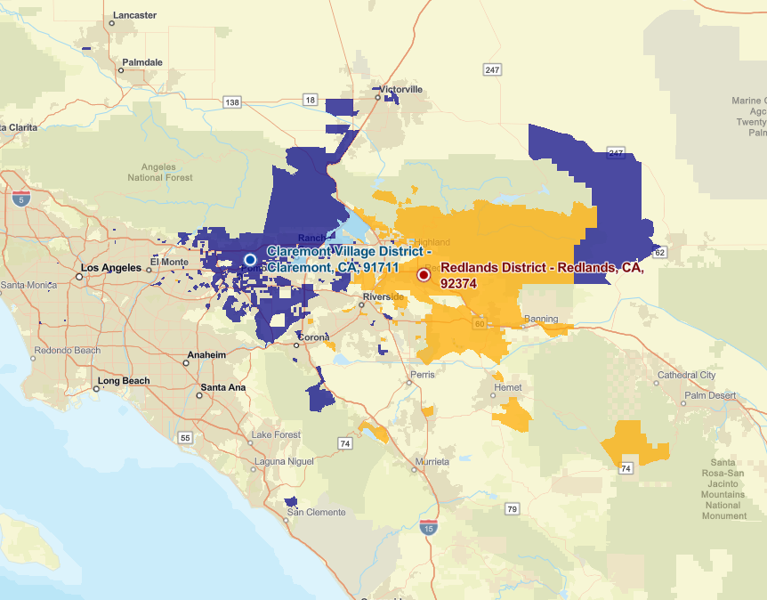
COMP Geographic Overlap
One per competitor selected.
One zoom out from default zoom.
XXXXX
Demographic | XXXXX Only | Overlap | COMP Only
Avg. HH Income
Households
Population
Legend
Visit only XXXXX
Visit only COMP
Visit both XXXXX & COMP

Slide 23
Year-on-Year Comparison
Insert photo of the client location or location being analyzed and resize/crop to fit properly, then ‘Send to back’
(Height: 14.0” x Width: 6.39”)
Delete this box

Slide 24







XXXXX Visitor: Where and Who FY 2023 vs. FY 2024
2023
2024
2023
2024
CHANGE
CHANGE
XX | XX
XX% | XX%
XX% | XX%
XX% | XX%
XX | XX
XX | XX
XX
XX%
XX
XX%
TruTrade Visitor
Origin Population
Average Income
$100k or more
Less than 20 miles
XX%
XX%
20-50 miles
College or Post-
Graduate Degree
More than 50 miles
XX%
XX%
Avg Distance
(Live within 50mi)
Having Children <18
Living at Home
Get details from
Dashboard > Report > Summary
Dashboard > Report > ZIP Codes
Dashboard > Report > Distance Travelled
For both Present and Previous Year.
Avg Distance
(Out-of-state Visitors)
Ethnic/Racial
Composition
2023
2024
78739, Austin, TX (25.4%)
78749, Austin, TX (6.8%)
78748, Austin, TX (5.4%)
78745, Austin, TX (4.3%)
78641, Leander, TX (3.0%)
78739, Austin, TX (19.8%)
78749, Austin, TX (6.7%)
78748, Austin, TX (4.5%)
78745, Austin, TX (3.2%)
78737, Austin, TX (2.6%)
Top 5
ZIP
Codes
Total Percent of Visits
44.9%
36.9%
Source: TruTrade (FY2023 vs FY2024)

Slide 25
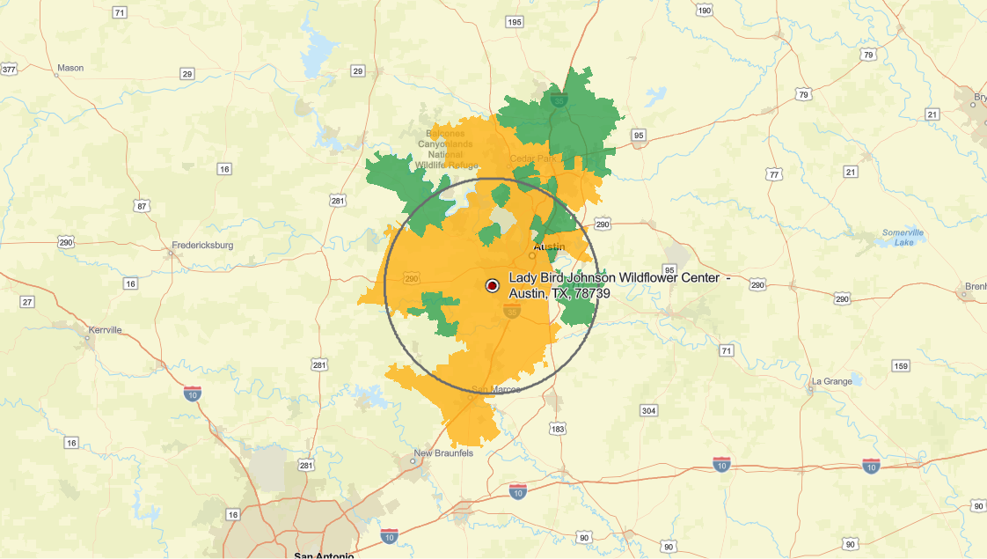
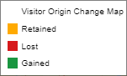
XXXXX Change Map
September 2022-August 2023 vs September 2023-August 2024
…
Get Map and Data from Dashboard>Overview> Compare Timeframes
Demographic | Retained in CY 2023 | Lost in CY 2023 | Gained in CY 2023
Avg. Income
Households

Slide 26

TruInsight™ – Visitor Digital Interests
Note: The following TI intro slides need to appear in any report that includes TI data for client context. Please be sure to have these in each template that includes TI (Destination & Shopping Centers)
IF client already received a Visitor Engagement report, then SKIP the TI section because that was included in that previous report

Slide 27





Update to Zoo, Bot. Garden, or Museum themed image, or client-specific
Digital and social media have become powerful sources of influence and attention for consumers today. ​
The average American spends 2 hours and 14 minutes on social media every day.​
46% of Americans say they watch more user-generated content on social media than they watch movies and television on streaming services. ​

Slide 28
What are interests of this audience to inform our exhibits and programs?
What media will best reach this audience?
What promotions or sponsorships will most resonate with this audience?
This report is designed to identify Interests, Influencers, and Media with which your visitors demonstrate a recent positive sentiment on social media and online platforms. This data provides comprehensive, detailed insights into what they are engaging with each day—on average for 2+ hours a day.
Brands, Media and Interests are identified based on monitored digital consumer behavior.
To be included, a consumer must be engaged with the brand – that is: following and positively engaging with that brand’s handle.
They must be mentioning, tweeting and showing positive sentiment for the brand within the past three months on channels including YouTube, Pinterest, Twitter, Instagram, etc.
Interests are categorized based on Internet Advertising Bureau categories.
These categories are intended to help digital agencies place advertising that will resonate/align with an audiences’ key interests.

Slide 29


The [audience] profile and [audience] profile are provided to identify more targeted opportunities
[Name] Audience
Mobile Device ID’s of visitors that were seen at your location between June 2022 and May 2023 were matched to online behaviors for 1.2B US consumer profiles.
The [Name] Audience shows the top brands and attributes with which [type] are most engaged.
The All visitor profile may be used in planning marketing messages, media mix, leasing prospects and more.
[Name] Audience
An audience of “[name]” consumers was built among the 1.2B profiles based on their engagement with a set of luxury brands and products.
[Type] were then matched to the [category] audience as a separate audience in TruInsight.
The Luxury visitor audience may be used in place of the general audience when working with luxury and aspirational retailers.
Customized to client
Customized to client
Update to Zoo, Bot. Garden, or Musuem themed image, or client-specific
Update to Zoo, Bot. Garden, or Musuem themed image, or client-specific

Slide 30
XXXXX Email Audience
TOP INTERESTS – MEDIA - INFLUENCERS
INTEREST (Overall) | NEWSPAPERS (All) | MAGAZINES (Lifestyle) | MAGAZINES (Fashion) | PODCASTS (All) | INFLUENCERS (Fashion) | INFLUENCERS (Home & Garden)
Sports | The New York Times | Bon Appetit Magazine | Vogue Magazine | Society & Culture | Christine Teigen | Martha Stewart
Arts And Entertainment | Austin American-Statesman | Bon AppÃ©tit Magazine | Vanity Fair | Comedy | Kim Kardashian | Joanna Gaines
Music | Texas Tribune | Martha Stewart Living | T Magazine | News | Melania Trump | Grace Bonney
Hobbies | The Wall Street Journal | National Geographic Traveler | Instyle | Sports | Khloe Kardashian | Chip Gaines
B2b | The Washington Post | Food Network Magazine | Wallpaper Magazine | Business | Kourtney Kardashian | Epic Gardening
News | The Guardian | Dwell Magazine | Elle Magazine | Music | Judd Apatow | Bri Emery
Family And Parenting | The Texas Observer | Real Simple | W Magazine | Arts | Kendall Jenner | Elsie Larson
Style And Fashion | Usa Today | Food & Wine Magazine | Nylon | Tv & Film | Kylie Jenner | Drew Scott - Actor
Science | Los Angeles Times | Conde Nast Traveler | Glamour | Politics/Government | Leandra Medine | Jonathan Scott
Politics / Advocacy | Financial Times (Uk) | Travel + Leisure | Marie Claire | Health & Fitness | Camille Styles | Clint Harp
Where to find audience details (set scaled audience from largest to smallest) –
Interest: interests
Newspapers: media > print media > newspapers
Magazines (lifestyle): media > print media > magazines > lifestyle
Magazines (fashion): media > print media > magazines > fashion
Podcasts: media > podcasts
Influencers (fashion): influencers > fashion / beauty
Influencers (home): influencers > home and garden
Source: TruInsight. Interests and mediums are listed in top ten audience size order from most-to-least visitor interest. Use these interests and mediums to inform new business development, specialty partnerships and digital marketing initiatives.

Slide 31
XXXXX Email Audience
TOP BRANDS BASED ON INTEREST
SHOES AND FOOTWEAR BRANDS | APPAREL BRANDS (Designer) | CONSUMER ELECTRONIC BRANDS | BEAUTY BRANDS (Cosmetics) | SPORTING GOODS BRANDS (Sportwear) | HOME FURNISHINGS BRANDS | JEWELRY BRANDS | RESTAURANTS / DINING CATEGORIES
Nike | Kate Spade | Best Buy | Sephora | Patagonia | West Elm | Kendra Scott | Fast Food
Toms | Chanel | Newegg | Chanel Beauty | Lululemon | Apartment Therapy | Catbird | Coffee
Zappos | Michael Kors | Gamestop | Glossier | Outdoor Voices | Home Building | Tiffany & Co | Dessert
Adidas | Burberry | Radioshack | Essie | The North Face | Williams-Sonoma | Rolex | Bbq
The North Face | Christian Louboutin | Apple Store | Benefit Cosmetics | Under Armour | Pottery Barn | Vrai | Family Restaurant
Burberry | Marc Jacobs | Smarthome Shopping | Lush | Athleta | One Kings Lane | Alex And Ani | Pizza
Sjp By Sarah Jessica Parker | Christian Siriano |  | Bobbi Brown | Alo Yoga | Home Goods | Baublebar | Juice/Salad Bars
Alexander Mcqueen | H&M |  | Mac Cosmetics | Topo Designs | The Citizenry | David Yurman | Fine Dining
Under Armour | Stella Mccartney |  | Narscosmetics.com | Gaiam | Herman Miller | Bulgari | Ethnic
Brooks | Diane Von Furstenberg |  | The Honest Company | Prana | Houzz | Cartier | Pub
Where to find audience details (set scaled audience from largest to smallest) –
Shoes and footwear: brands > style and fashion > shoes and footwear
Designer: brands > style and fashion > apparel > designer
Consumer electronics: technology > consumer electronics retailers
Beauty: brands > consumer packaged goods > personal care > cosmetics
Sporting goods: brands > style and fashion > apparel > sportswear
Home: brands > home and garden > home furnishings and houseware
Jewelry: brands > style and fashion > jewelry
Restaurants: brands > restaurants
Source: TruInsight. All other brands are listed in top ten audience size from most-to-least visitor interest.

Slide 32
Appendix
Insert photo of the client location or location being analyzed and resize/crop to fit properly, then ‘Send to back’
(Height: 14.0” x Width: 6.39”)
Delete this box

Slide 33
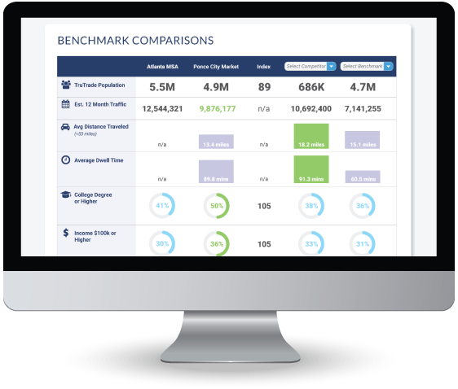
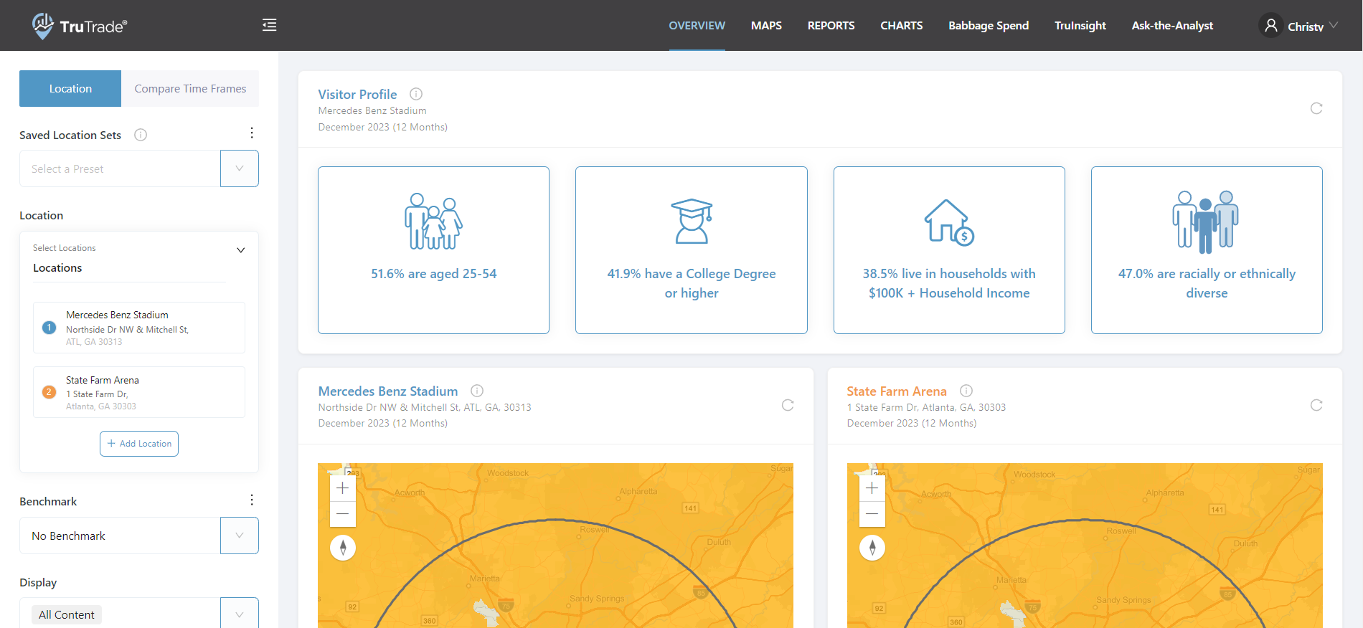
TruTrade 5.0 Dashboard Access
Dashboard access to TruTrade is available online 24/7:
https://trutrade.alexanderbabbage.com
If additional logins are needed, please contact Christy Loudermilk at:
cloudermilk@alexanderbabbage.com
If you need access to additional locations within your dashboard, please submit a request for additional locations on the “My Profile” page

Slide 34
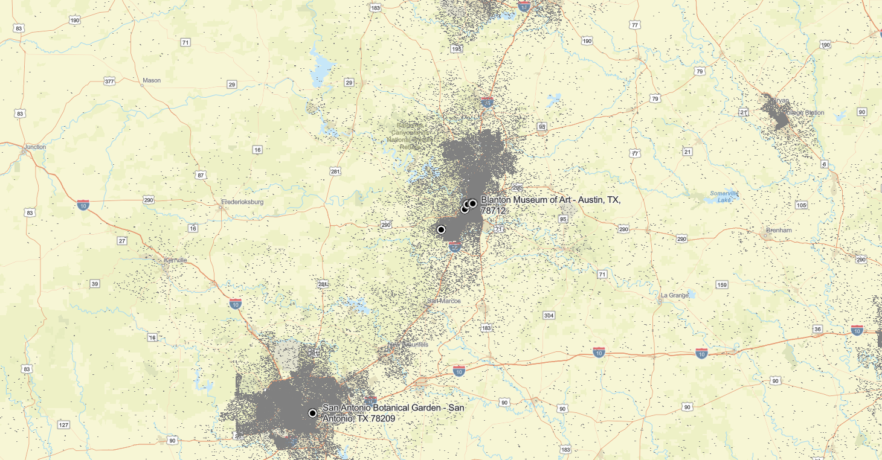

Regional Population Density
Delete map to left and update with POPULATION DENSITY map (identical zoom as the first Visitor Origin and first Geographic Penetration and the Overlay maps, all competitors, but no mileage ring)
Size map to correct size
(Height: 10.14” x Width: 7.92”)
Slide 37 PPT Export
…
XXXXX

Slide 35
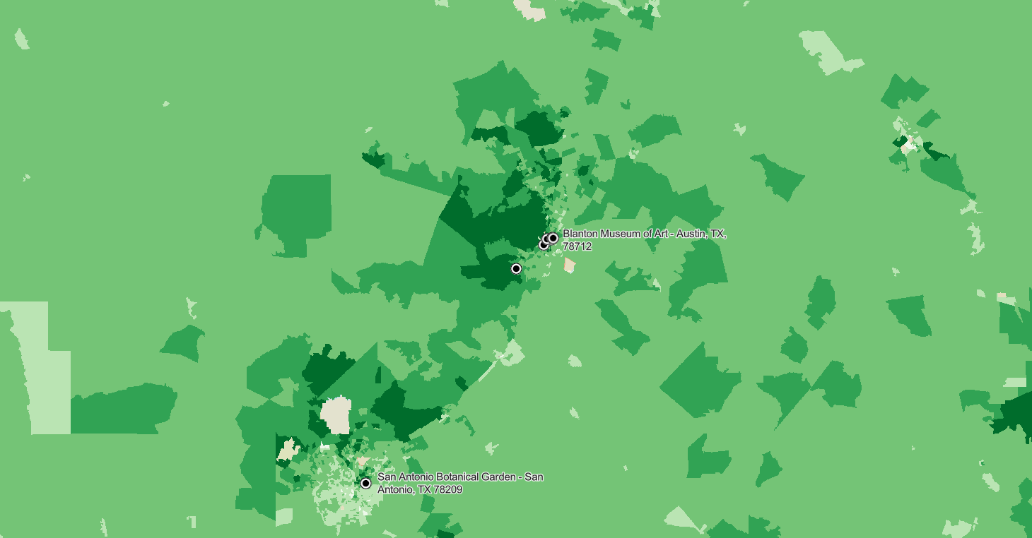
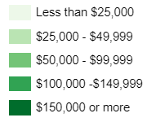
Regional Income Distribution
Delete map to left and update with HOUSEHOLD INCOME map (identical zoom as the first Visitor Origin and first Geographic Penetration and the Overlay maps, all competitors, but no mileage ring)
Size map to correct size
(Height: 10.14” x Width: 7.92”)
Slide 31 PPT Export
…
XXXXX

Slide 36
DEFINITIONS
Demographics – the demographics of the block group of the home location for the device. This allows comparisons between the demographic make up of the households who are visiting a location but may not reflect the actual visitor.
Demographic Indices – the demographic profile of a given center indexed against the market. This is the easiest way to see the strengths and opportunities for a given location.
Visitor Distance Traveled – the distance from the center of the block group to the location, used to compare between locations and compute a weighted average distance. Note, this will not compare to traditional methods as it includes the distance traveled for people who have flown to the market (e.g. on business, or for leisure) and who are visiting the location. Can be used to see which location has the biggest regional or national draw.
Visitor Frequency – the number of times the same device was seen at a given location during the tested 12-month period.
Visitor Duration – the duration between the first and last “pings” to the mobile application while at the location.
Top 25 ZIPs – trips are organized based on number of trips to a given location, then sorted into the top 25 ZIPs that produce visits to that location. The table is sorted on Percent of Visits.
Visitor Origin – Visitor Origin is defined by ranking block groups in descending order based on 1.) the number of trips originating from each block group, and 2.) the Average Household Income for each block group. The percent of visits from each block group, along with a cumulative total, is calculated and the block groups that represent the top 75% of visits are shown on the Visitor Origin map.
Visitor Origin Population – sum of the population of the block groups which comprise the top 75% of location visits.

Slide 37
DTANALYSIS37
Estimated Distance Traveled
 | Less than 5 miles | 5 to 10 miles | 11 to 20 miles | 21 to 50 miles | More than 50 miles | Avg. Distance (miles) | Avg. Distance (<50mi)
Average of studied locations
Source: TruTrade, 12 months ending on March 31, 2022; Esri

Slide 38
FREQANALYSIS38
Annual Visit Frequency
 | Visited once | Visited 2-4 times | Visited 5+ times | Avg. Number Annual Visits
Average of studied locations
Copy/paste table data from “Frequency” tab in workbook
Update ending month in footnote at bottom
Delete this box
Source: TruTrade, 12 months ending on March 31, 2022; Esri

Slide 39
DURANALYSIS39
Copy/paste table data from “Duration” tab in workbook
Update ending month in footnote at bottom
Delete this box
Visit Duration
 | Less than 15 mins. | 15 to 60 mins. | 60 mins. to 3 hours | More than 3 hours | Average Duration (mins)
Average of studied locations
Source: TruTrade, 12 months ending on March 31, 2022; Esri

Slide 40
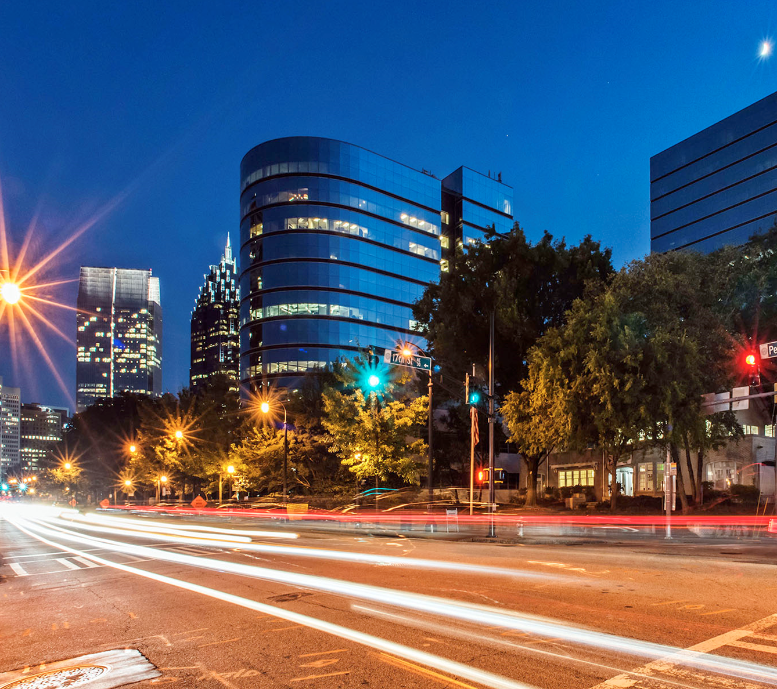
Christy’s Version
Alan McKeon
President & CEO
amckeon@alexanderbabbage.com
Stacy Sheldon
Vice President of Client Insights
ssheldon@alexanderbabbage.com
Christy Loudermilk
Client Success Manager
cloudermilk@alexanderbabbage.com

Slide 41
Erica’s Version
Alan McKeon
President & CEO
amckeon@alexanderbabbage.com
Stacy Sheldon
Vice President of Client Insights
ssheldon@alexanderbabbage.com
Erica Brown
Client Success Manager
ebrown@alexanderbabbage.com

